Slide 1


Introduction to React
React is a popular JavaScript library for building user interfaces. It provides a component-based architecture that encourages code reusability and maintainability. React is known for its virtual DOM, which enhances performance and makes it a great choice for building dynamic and interactive web applications.
by 22H51A0542-MOHAMMED JAFAR SADIQ B.Tech-CSE(2022-26)

Slide 2
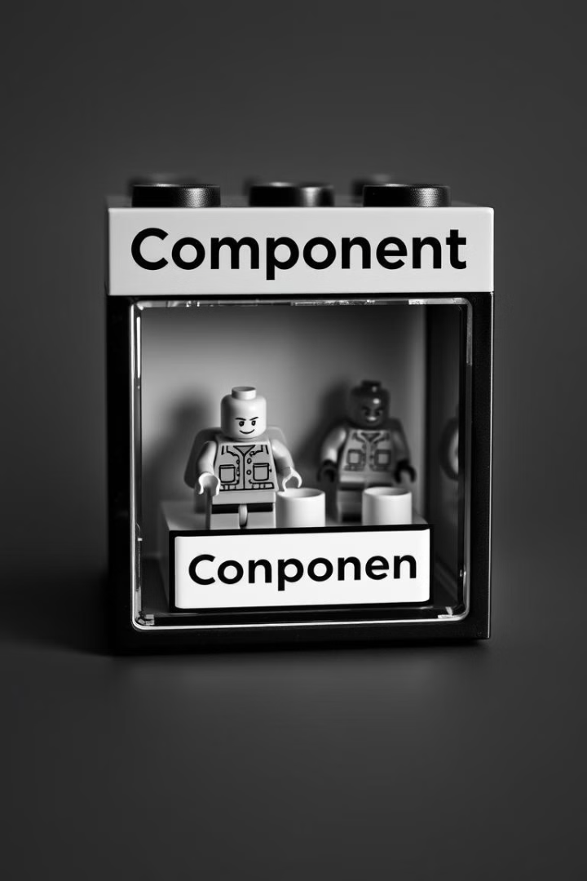
React Components
React components are the building blocks of React applications. They are independent and reusable units of UI code. Each component can have its own state and logic, which makes them highly flexible.
Functional Components
Class Components
These are more complex and allow for state management and lifecycle methods.
These are simple functions that accept props and return JSX.

Slide 3
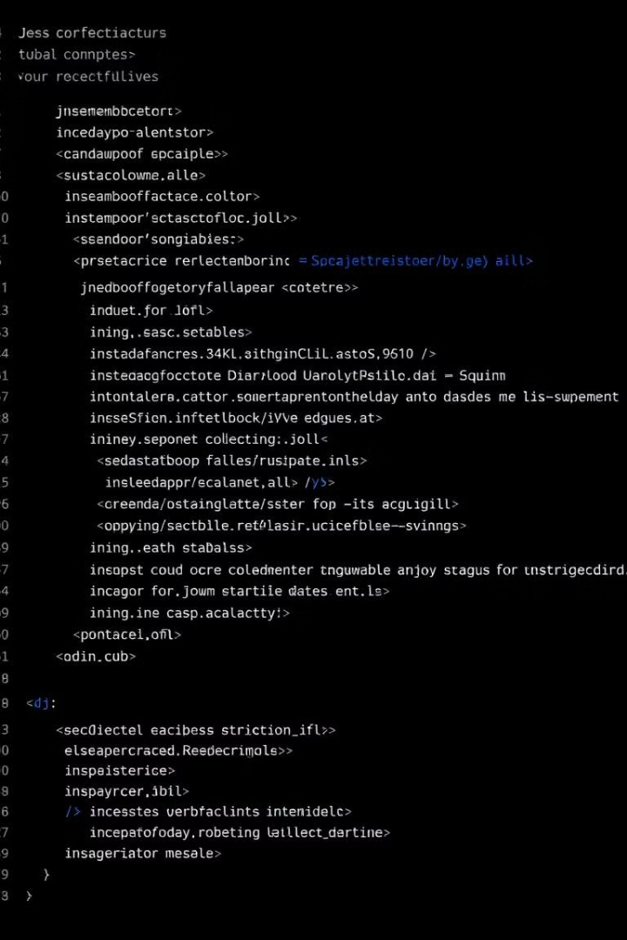


JSX Syntax
JSX is a syntax extension for JavaScript that lets you write HTML-like structures directly in your JavaScript code. It offers a declarative and expressive way to define UI elements. React compiles JSX into regular JavaScript code.
HTML-like Structures
Use tags like `
`, ``, and `
JavaScript Expressions
Embed JavaScript code within curly braces to dynamically generate content.
Component Composition
Use components as building blocks to create complex UI layouts.

Slide 4

State Management
State refers to the data that changes over time in a React component. Managing state efficiently is crucial for building dynamic applications. There are various state management libraries that can be used.
1
useState Hook
2
Context API
3
Redux
The basic hook for managing state within a component.
Provides a way to share state across different components.
A popular library for managing global state.

Slide 5
Props and Data Passing
Props are used to pass data from parent components to child components. They allow you to share information and create interconnected components.
Parent Component
Child Component
Renders a child component and passes props.
Receives props and uses them to render its own content.

Slide 6




Conclusion and Resources
React is a powerful and versatile library that allows you to build modern and engaging user interfaces. With its component-based architecture and extensive ecosystem, it offers a robust framework for building interactive applications.
Documentation
Community
Tutorials
The official React documentation provides comprehensive information on all aspects of the library.
Join React communities on platforms like Stack Overflow and Reddit to learn from others and get help.
Explore online tutorials and courses to enhance your understanding of React concepts.

